Slide 1
Markus Hug 15.02.2016

Slide 2
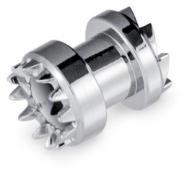
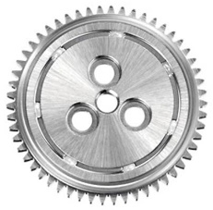
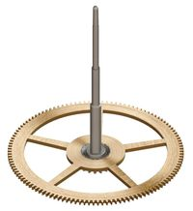
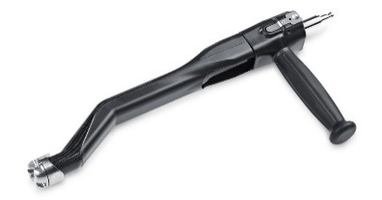
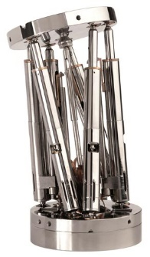
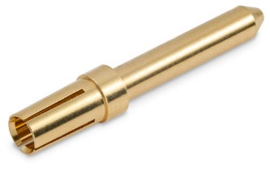
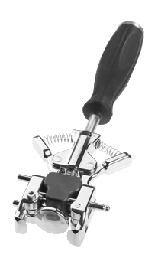
MPS Group Organisation
MPS Group
MPS Watch
MPS Precimed
MPS Décolletage
MPS Microsystems
150 employees
Location: Bonfol
Watch bearings and gear wheels
150 employees
Location: Bienne
Microsystems, ball screws, linear bearings
80 employees
Location: Corgémont
Orthopedic instruments
20 employees
Location: Court
Precision decolletage parts

Slide 3
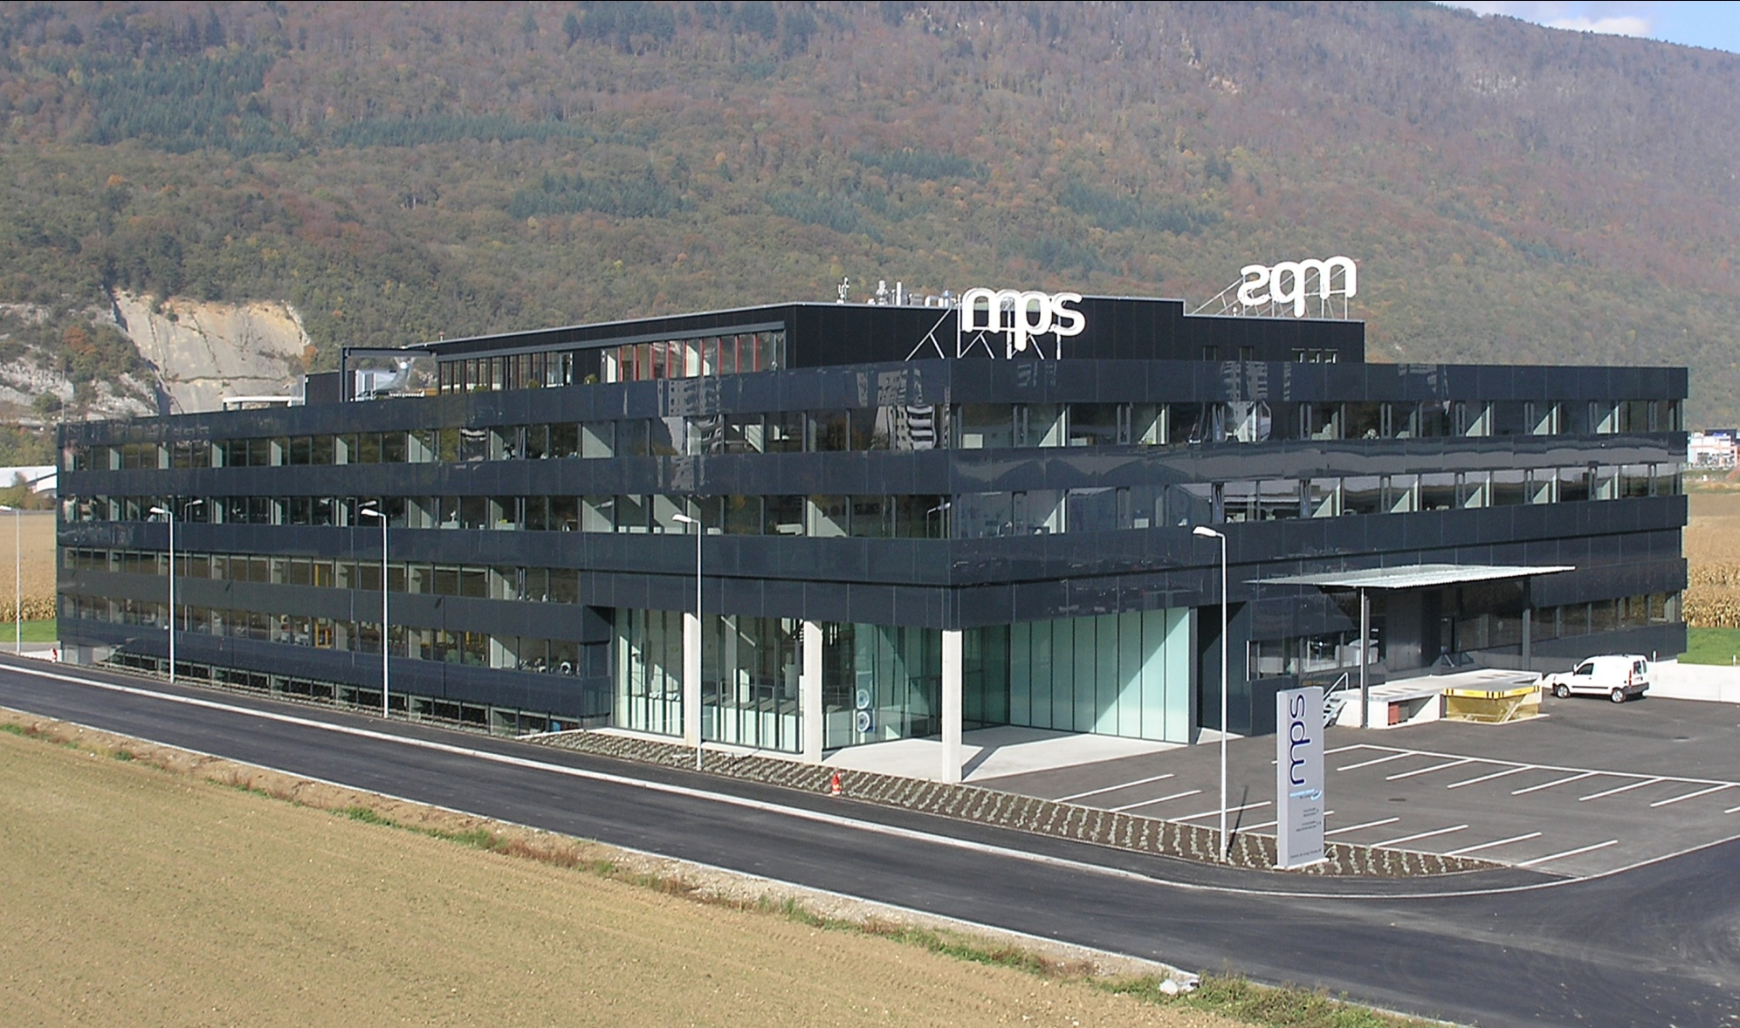
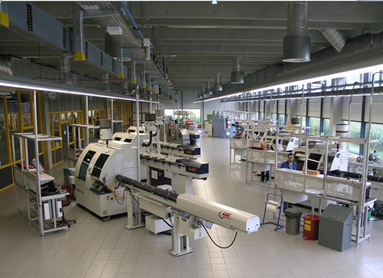
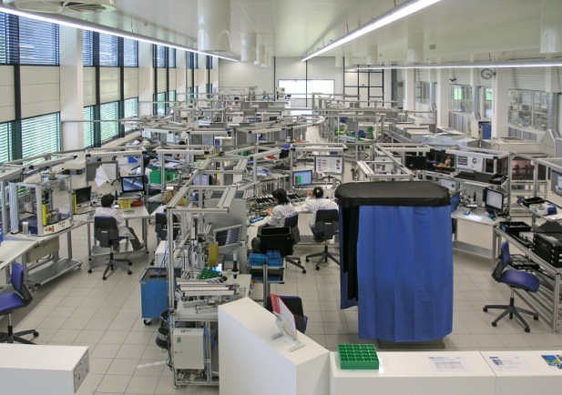
MPS Microsystems
Located in Biel/Bienne, Switzerland
14’400 m2 built in 2008
150 employees
ISO 9001 – ISO 14001 - ISO 13485
Research & Development
Industrialization
Parts manufacturing :
- turning, grinding,
- ball bearing manufacturing,
- thermal and surface treatment.
Microsystems assembly (clean room)
Purchasing and logistic
Quality assurance and Quality control

Slide 4
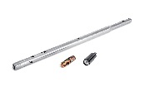
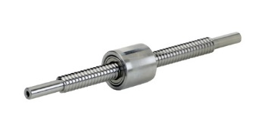
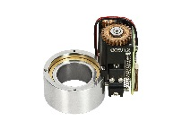
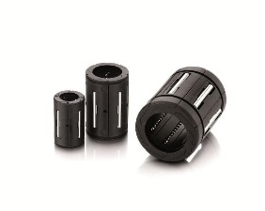
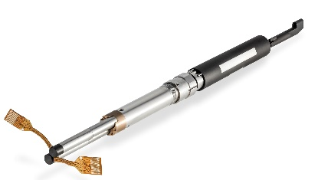
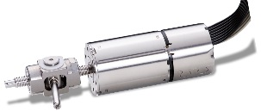
MPS Microsystems products and applications
Standard Products (Microlinea) | Engineered solutions
Ball screws Linear bearings (L-Line) Linear bearings (DBL lines) | Active implants Medical robotics Automation Optics Science Defense

Slide 5
Robot Manufacturing Process
Markus Hug 15.02.2016

Slide 6
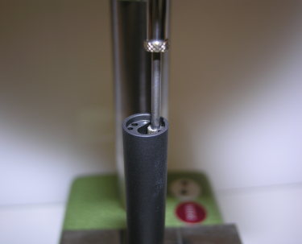
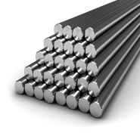
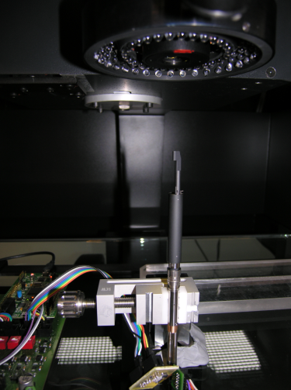
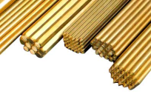
Overview
Assembly & Test
Raw materials
Manufacturing
Turning & Milling
Surface & Heat Treatment
Grinding & Finishing

Slide 7
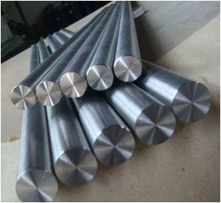
Raw materials
Martensitic & austenitic stainless steels
Copper alloys
Aluminum alloys
Plastics
Special materials
Etc.

Slide 8
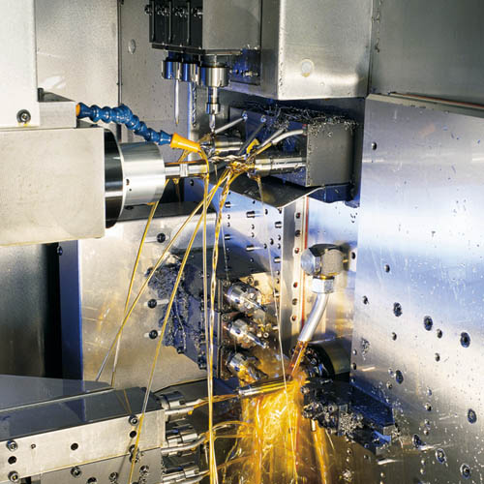
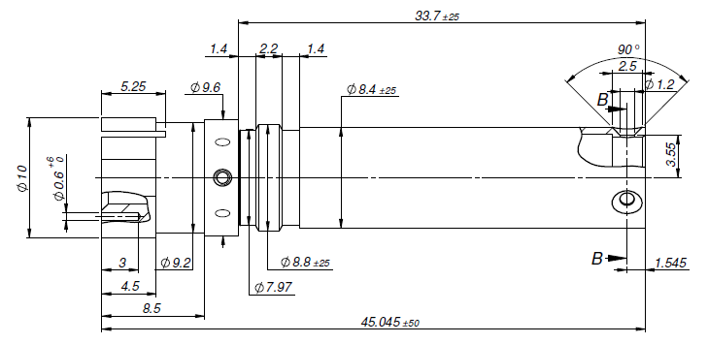
Turning
Swiss-type turning
Holder
Usual tolerances | Usual run-out & concentricity | Usual hardness
± 6 µ for Ø < 10 mm ± 10 µ for Ø ≥ 10 mm | Down to 10 µ depending on part complexity | According to raw material

Slide 9
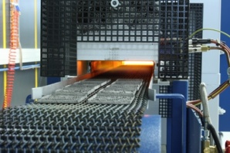
Heat treatment
Heat treatment :
Annealing
Quenching
Cryogeny
Tempering
Usual tolerances | Usual run-out & concentricity | Usual hardness (AISI 440C)
- | ↗ Study of deformation due to heat treatment | Min. 61 HRC

Slide 10
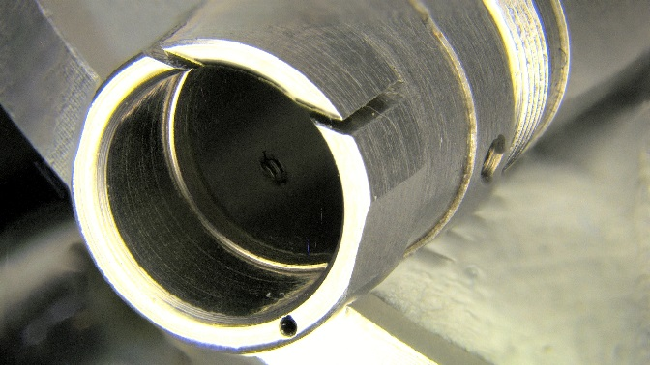
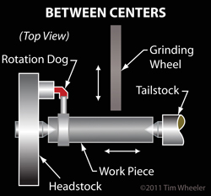
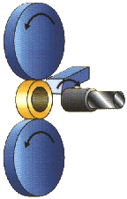
Grinding
Outer Ø and thread grinding
between centers
Inner Ø grinding – centerless,
rolling on grinded OD
Usual tolerances on Ø | Usual run-out & concentricity | Usual hardness (AISI 440C)
+/- 3 µ | 5 µ | Min. 61 HRC

Slide 11
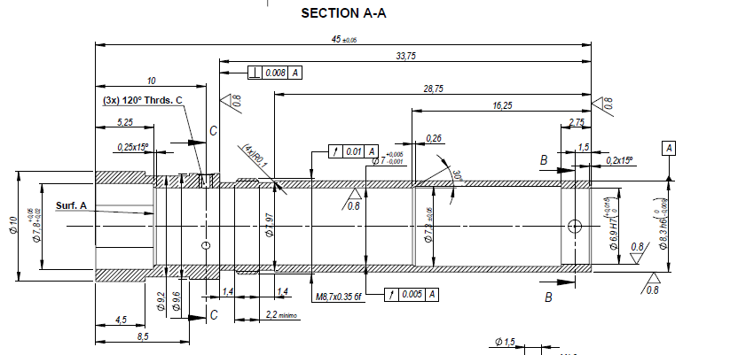
Grinding

Slide 12
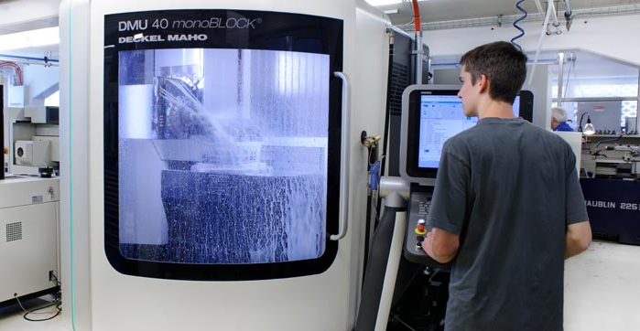
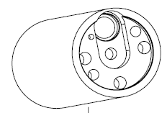
Milling
5-axis milling
R2-Support
Usual tolerances | Usual geometrical tolerances | Usual hardness
Down to ± 5 µ depending on part complexity | Down to 10 µ depending on part complexity | According to raw material

Slide 13
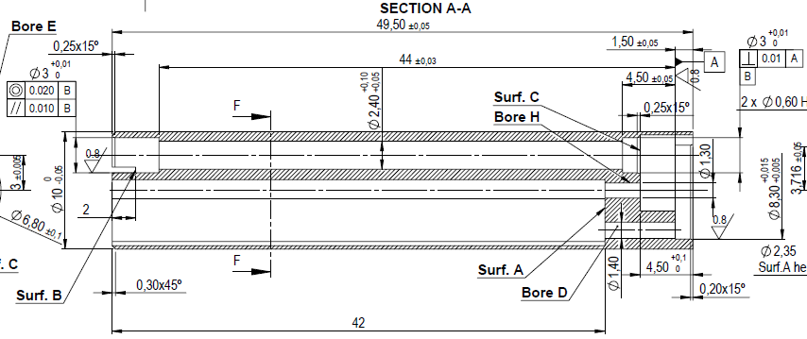
Milling

Slide 14
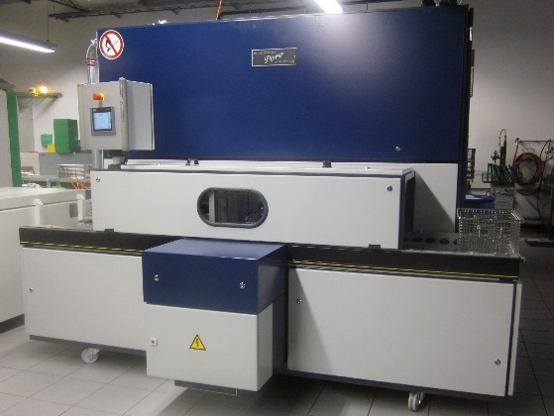
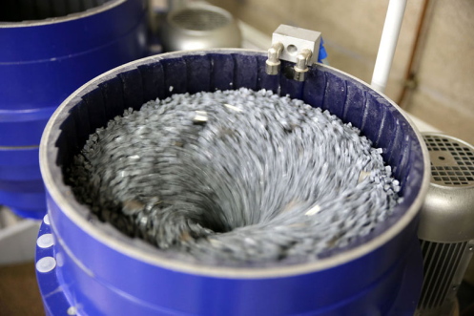
Surface treatment
Cleaning & degreasing
Vibratory deburring
Cutting oil, burrs, chips, etc.

Slide 15
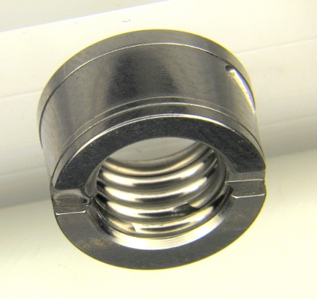
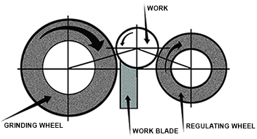
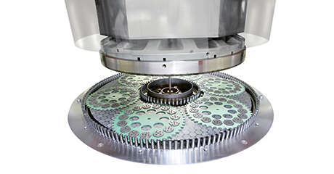
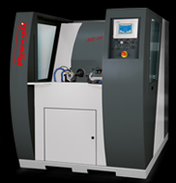
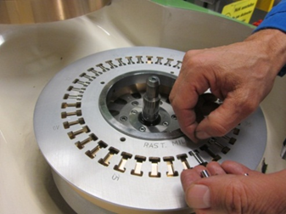
Other processes
Continuous feed centerless grinding
Inner thread grinding
Manual deburring & visual inspection
Lapping
Honing
Polishing

Slide 16
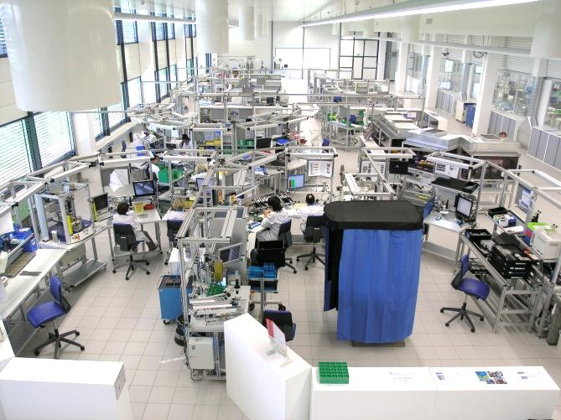
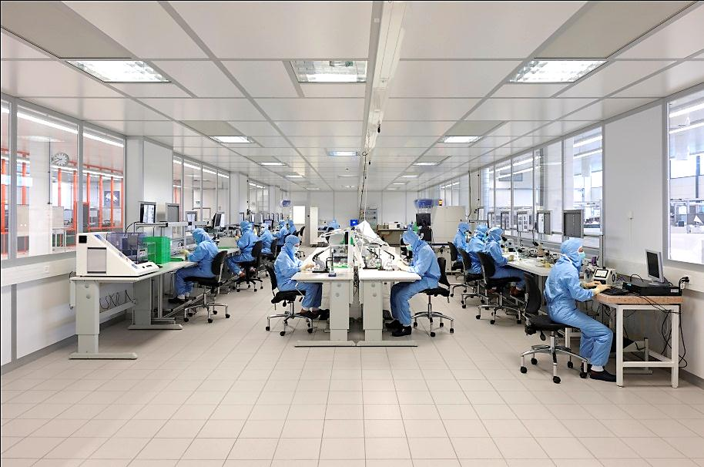
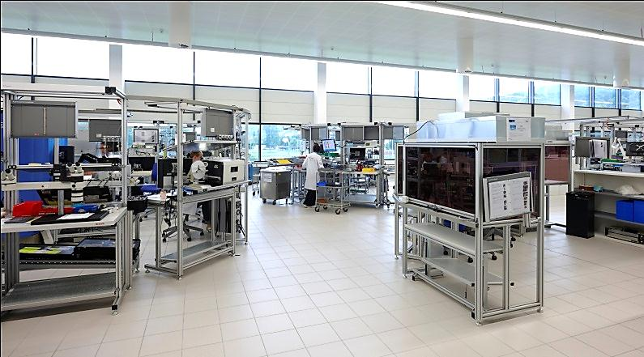
Assembly
General assembly environment
Cleanroom class 100’000
Special assembly environment
Cleanroom class 10’000
Flow cells
Air stream class 1’000

Slide 17
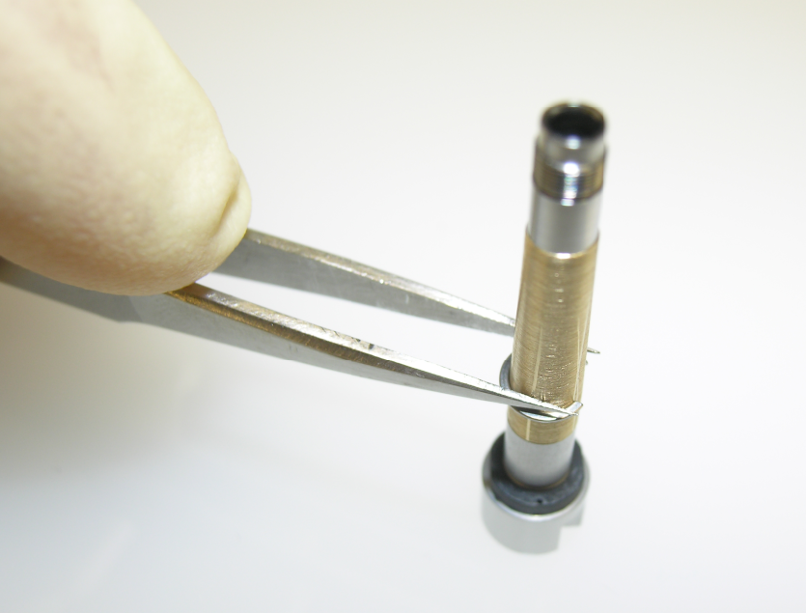
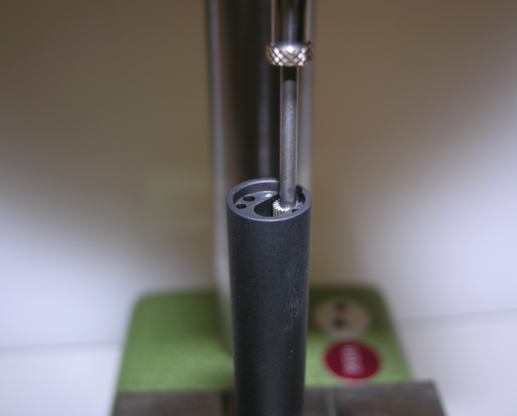
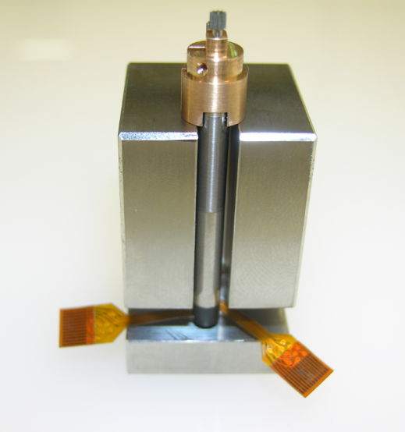
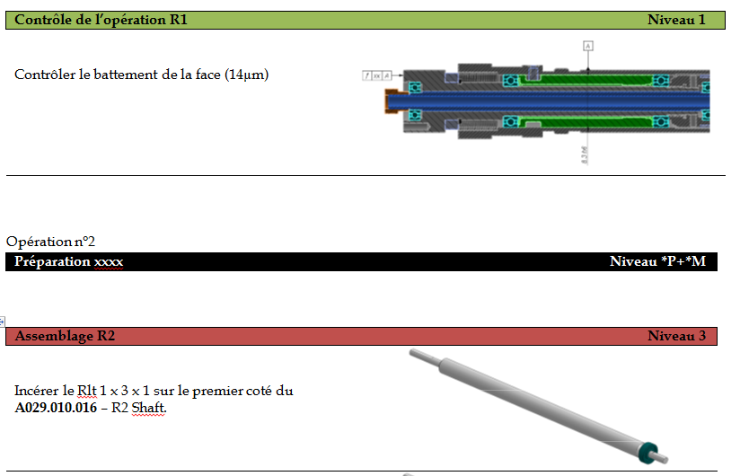
Assembly
Project specific assembly
Processes
Process manuals with visual aids
Tooling's
in the field of precision mechanics

Slide 18
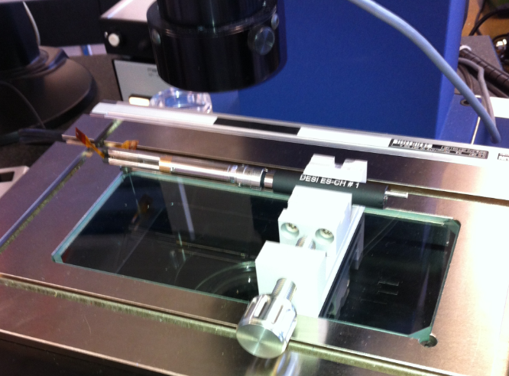
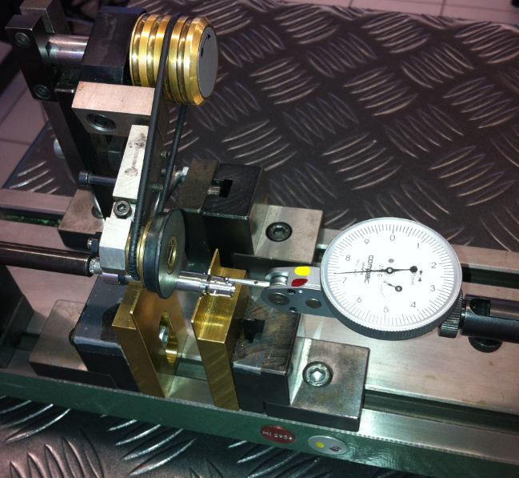
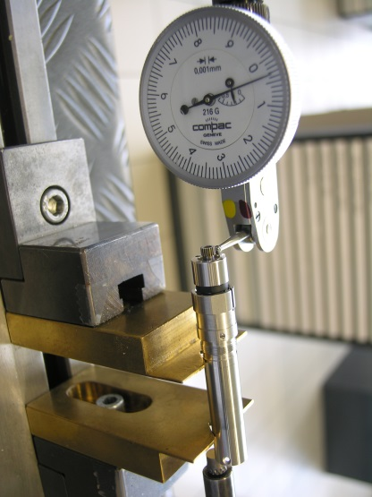
Assembly
Project specific assembly
In process controls
Measurement devices (Metrology)
in the field of precision mechanics

Slide 19
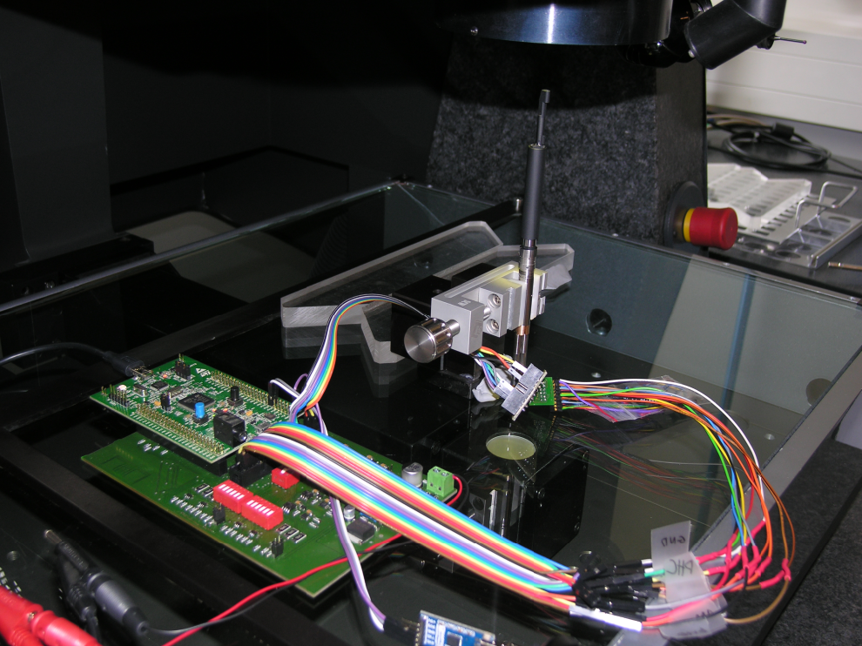
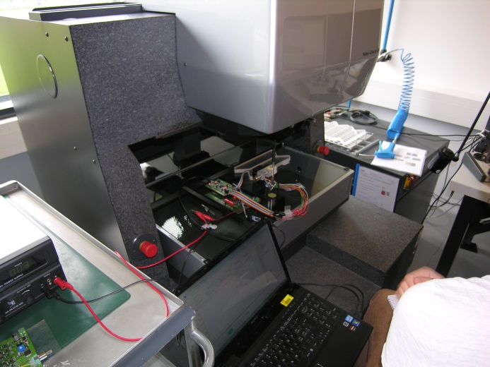
Final Tests
Werth 3D measurement device
Optical and tactile
Resolution 0.5µm
Repeatability ±2µm
Measurements samples for the Actuator
X/Y Position accuracy
Max angular tilt R1 – R2

